Slide 1

DEPARTMENT OF ARTIFICAL INTELLIGENCE AND DATA SCIENCE
Project Phase-2
Review 1
“A Hybrid Neural Network for EEG-based Depression Screening Using CNN”
Project Team Members
Name USN
B.LATHA SREE 1SJ22AD006
C S MOUNIKA 1SJ22AD008
M.CHARAN 1SJ22AD024
Project Guide
Badrinath K
Assistant Professor

Slide 2

A Hybrid Neural Network for EEG-based Depression Screening Using CNN
TABLE OF CONTENTS
  Problem Statement
  Abstract
  Introduction
  Objectives
  Detailed Design and Architecture
  Modules Split-up
  Conclusion

Slide 3
A Hybrid Neural Network for EEG-based Depression Screening Using CNN
PROBLEM STATEMENT
Depression is a major mental health issue affecting over 322 million people worldwide, contributing to significant emotional, social, and economic burdens. Traditional methods for diagnosing depression, such as clinical interviews and self-reported questionnaires, are subjective and time-consuming. EEG-based diagnosis provides objective insights into brain activity but is prone to human error due to the complexity of interpreting EEG signals. Thus, there is a critical need for an automated and accurate depression screening system using EEG signals.

Slide 4
A Hybrid Neural Network for EEG-based Depression Screening Using CNN
ABSTRACT
Depression is a widespread psychological disorder affecting people of all ages. Early diagnosis is crucial, and EEG signals can help assess mental health. This project proposes a fully automated Depression Detection System using a novel Hybrid Neural Network, DepHNN, which combines CNN for temporal learning and LSTM for sequence learning. EEG data from 21 depressed and 24 normal drug-free individuals were used. The system achieves High accuracy and a MAE of 0.2040, offering an efficient, accurate, and low-complexity solution for EEG-based depression screening.

Slide 5
A Hybrid Neural Network for EEG-based Depression Screening Using CNN
INTRODUCTION
Depression affects over 322 million people worldwide, with a higher incidence among females. Although it is a treatable condition, nearly half of the cases remain undiagnosed due to factors like limited awareness, insufficient resources, and incorrect diagnoses. EEG signals, being non-invasive and cost-effective, serve as valuable biomarkers for identifying neurological disorders, including depression. However, their complexity makes manual analysis challenging. To address this, the project proposes a hybrid LSTM-CNN model (DepHNN) for efficient and accurate detection of depression using EEG data.

Slide 6
A Hybrid Neural Network for EEG-based Depression Screening Using CNN
OBJECTIVES
Design a CNN-LSTM model to automate depression detection using EEG signals.
Improve adaptability using cross-validation and diverse datasets while employing regularization techniques like L2 regularization and adaptive learning rates.
Enhance model accuracy and generalization through techniques such as dropout, data augmentation, and early stopping.
Reduce computational complexity and latency for real-time depression screening on portable and cloud-based platforms.

Slide 7
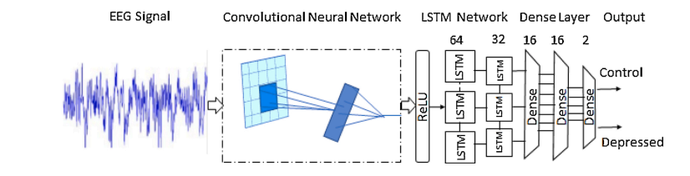
A Hybrid Neural Network for EEG-based Depression Screening Using CNN
  DETAILED DESIGN AND ARCHITECTURE
Proposed Architecture

Slide 8

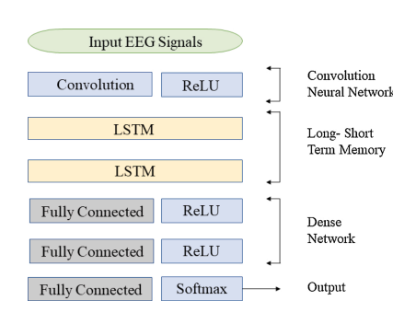
A Hybrid Neural Network for EEG-based Depression Screening Using CNN
Model Architecture

Slide 9
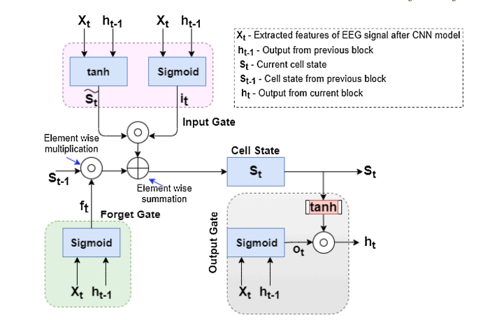
A Hybrid Neural Network for EEG-based Depression Screening Using CNN
LSTM Architecture

Slide 10
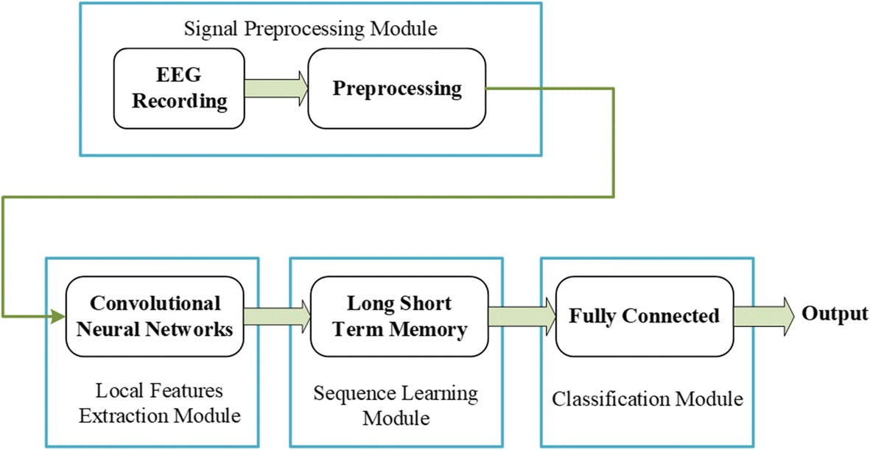
A Hybrid Neural Network for EEG-based Depression Screening Using CNN
Flow Chart

Slide 11
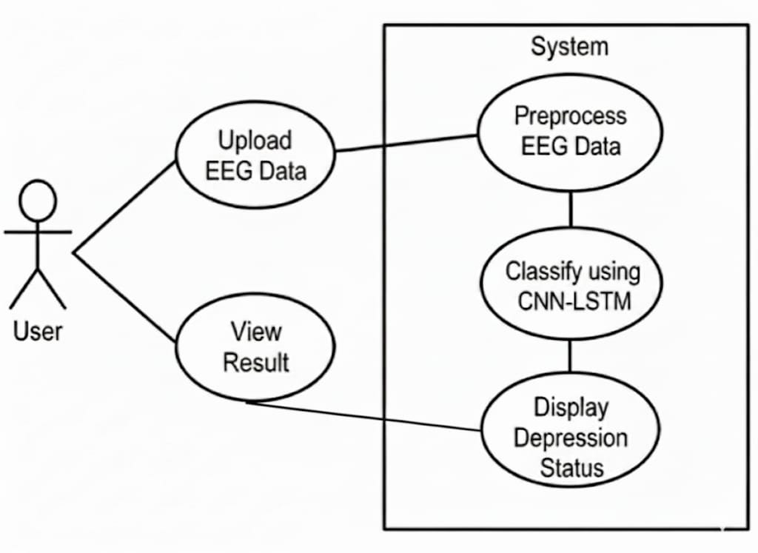
A Hybrid Neural Network for EEG-based Depression Screening Using CNN
Use Case Diagram

Slide 12
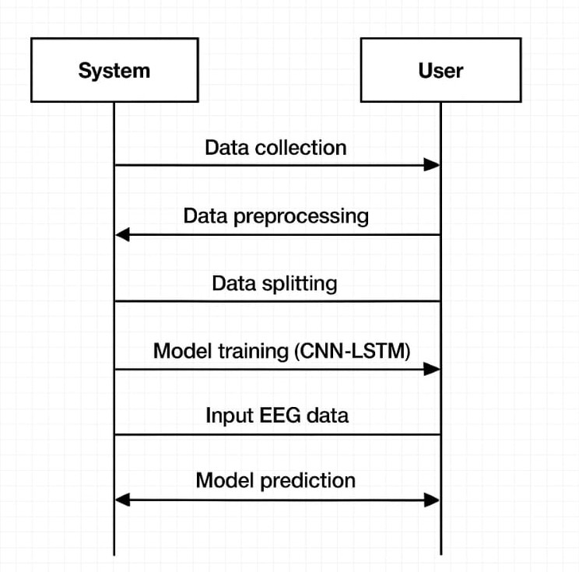
A Hybrid Neural Network for EEG-based Depression Screening Using CNN
Sequence Diagram

Slide 13
.
A Hybrid Neural Network for EEG-based Depression Screening Using CNN
MODULES SPLIT-UP
LIST OF MODULES
CNN (Convolutional Neural Network)
LSTM (Long Short-Term Memory)
ReLU (Rectified Linear Unit)
Softmax

Slide 14
A Hybrid Neural Network for EEG-based Depression Screening Using CNN
Module 1: CNN(Convolutional Neural Network)
CNN is a is a deep learning model mainly used for feature extraction from data such as images or EEG signals.
It captures spatial and temporal patterns automatically using convolution and pooling operations.
Purpose in the Model:
Extracts key spatial features from EEG data.
Captures local signal patterns automatically.
Reduces manual feature extraction.
Provides feature maps for LSTM processing.

Slide 15
.
A Hybrid Neural Network for EEG-based Depression Screening Using CNN
Module 2:LSTM (Long Short-Term Memory)
LSTM is a type of Recurrent Neural Network (RNN) designed to model time-series or sequential data by remembering long-term patterns.
It uses internal memory (called cells) and gates to regulate the flow of information.
Purpose in the Model:
Remembers important patterns over multiple time steps.
Helps understand temporal dependencies in EEG signals.
Improves performance on sequence data like brainwave activity.
Avoids vanishing gradient problems found in traditional RNNs.

Slide 16
A Hybrid Neural Network for EEG-based Depression Screening Using CNN
Module 3: Softmax
Softmax is an activation function used in the output layer of a neural network for classification tasks.
It converts raw scores (logits) into probabilities, so that the sum of all output values equals 1
Purpose in the Model:
Converts the model’s raw output into interpretable probabilities.
Helps the model make a clear decision about which class (e.g., depressed / not depressed) the input belongs to.
Ensures the output is a probability distribution.
Module 4:ReLU (Rectified Linear Unit)
ReLU is an activation function used in neural networks.
Purpose in the Model:
Adds non-linearity to the model.
Allows the neural network to learn complex features.
Speeds up convergence compared to sigmoid/tanh

Slide 17
A Hybrid Neural Network for EEG-based Depression Screening Using CNN
CONCLUSION
DepHNN is a hybrid deep learning model combining CNN and LSTM for automated depression detection using EEG signals. It efficiently extracts temporal and sequential features without manual engineering and achieves high accuracy with minimal error and computation time. The model surpasses existing approaches in accuracy, efficiency, and robustness, making it a reliable computer-aided tool for early depression screening. Future improvements can enable severity analysis, use of larger datasets, and integration with IoMT systems for real-time mental health monitoring.

Slide 18
A Hybrid Neural Network for EEG-based Depression Screening Using CNN
REFERENCES
[1] Automated EEG-based screening of depression using deep convolutional neural network, U. R. Acharya, H. Fujita, S. L. Oh, Y. Hagiwara, J. H. Tan, and M. Adam
https://doi.org/10.1016/j.compbiomed.2018.06.008
[2] Deep convolutional neural network model for automated diagnosis of depression using EEG signals, S. L. Oh, U. R. Acharya, Y. Hagiwara, J. H. Tan, and H. Adeli
https://doi.org/10.3390/app9153319
[3] Implementation guides for CNN and LSTM using Keras’ Sequential API.
https://keras.io/guides/sequential_model/
[4] U.R. Acharya, S.L. Oh, Y. Hagiwara, J.H. Tan, H. Adeli, D.P. Subha, Automated EEG-based screening of depression using deep convolutional neural network, Comput. Methods Programs Biomed. 161 (2018) 103–113. https://www.sciencedirect.com/science/article/pii/S0169260718301494
[5] Electroencephalogram (EEG)-based computer-aided technique to diagnose major depressive disorder (MDD)” by W. Mumtaz, L. Xia, S. S. A. Ali, M. A. M. Yasin, M. Hussain, A. S. Malik (2017), https://www.sciencedirect.com/science/article/abs/pii/S1746809416300866
[6] Deep convolutional neural networks for computer-aided detection: CNN architectures, dataset characteristics and transfer learning” by H.-C. Shin, H. R. Roth, M. Gao, L. Lu, Z. Xu, I. Nogues, J. Yao, D. Mollura, R. M. Summers (2016), https://pubmed.ncbi.nlm.nih.gov/26886976/

Slide 19


